Slide 1

IHC – Practical Presentation 1 Transdev
João Santos 110555
José Gameiro 108840
Ricardo Almeida 110056

Slide 2
Contents of this Assignement
Presenting Transdev
Heuristics Evaluation
Cognitive Walkthrough
Results
Conclusions
2

Slide 3

What is Transdev?
Why Transdev?
Main Purpose
3

Slide 4
Heuristics Evaluation
What is an Heuristic Evaluation
Heuristic evaluation is a process where experts use rules of thumb to measure the usability.
Severity Scale
0 = I don't agree that this is a usability problem at all
1 = Cosmetic problem
2 = Minor usability problem
3 = Major usability problem
4 = Usability catastrophe
4

Slide 5
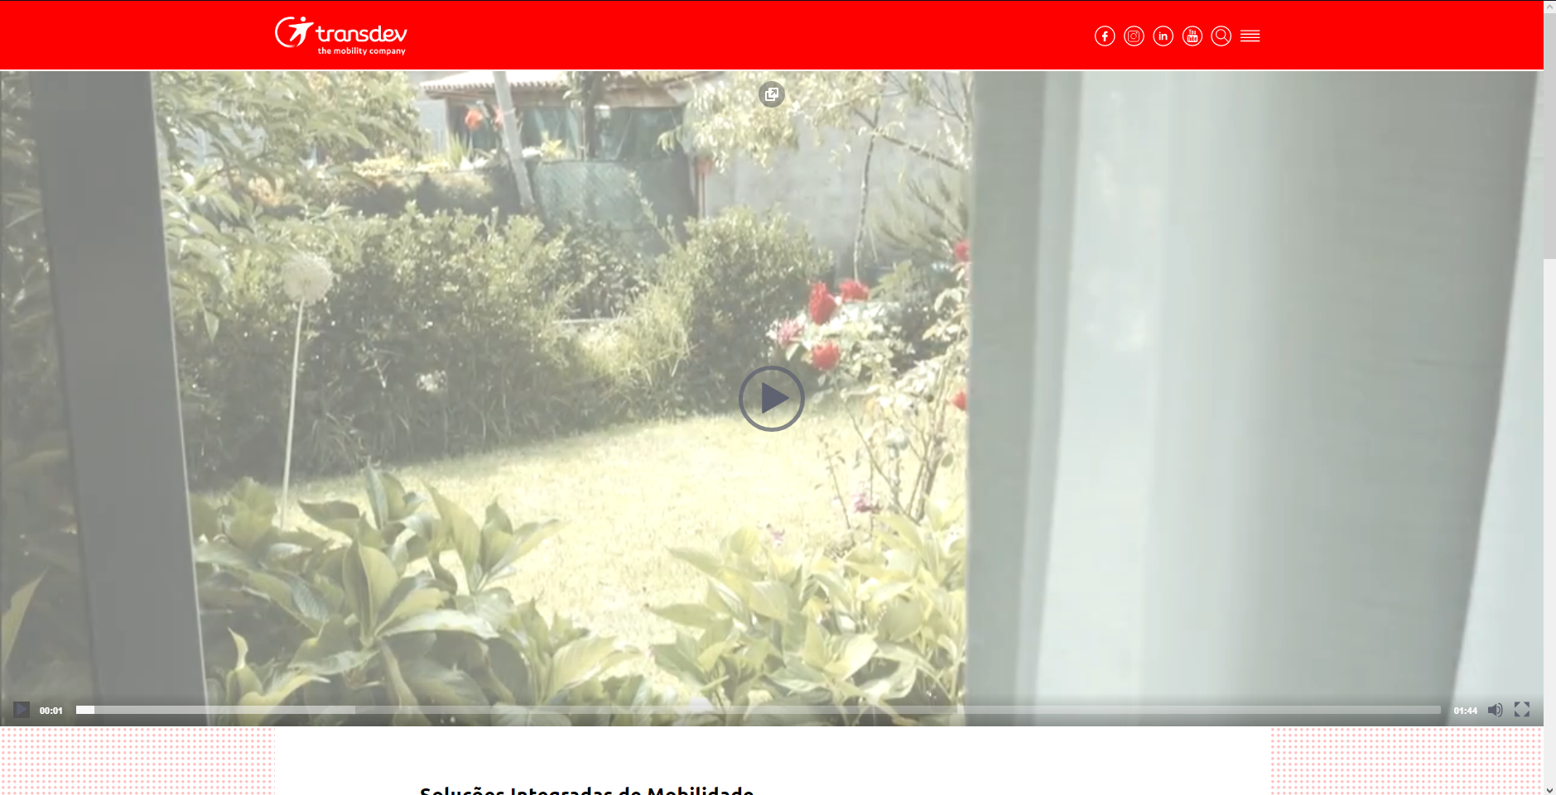
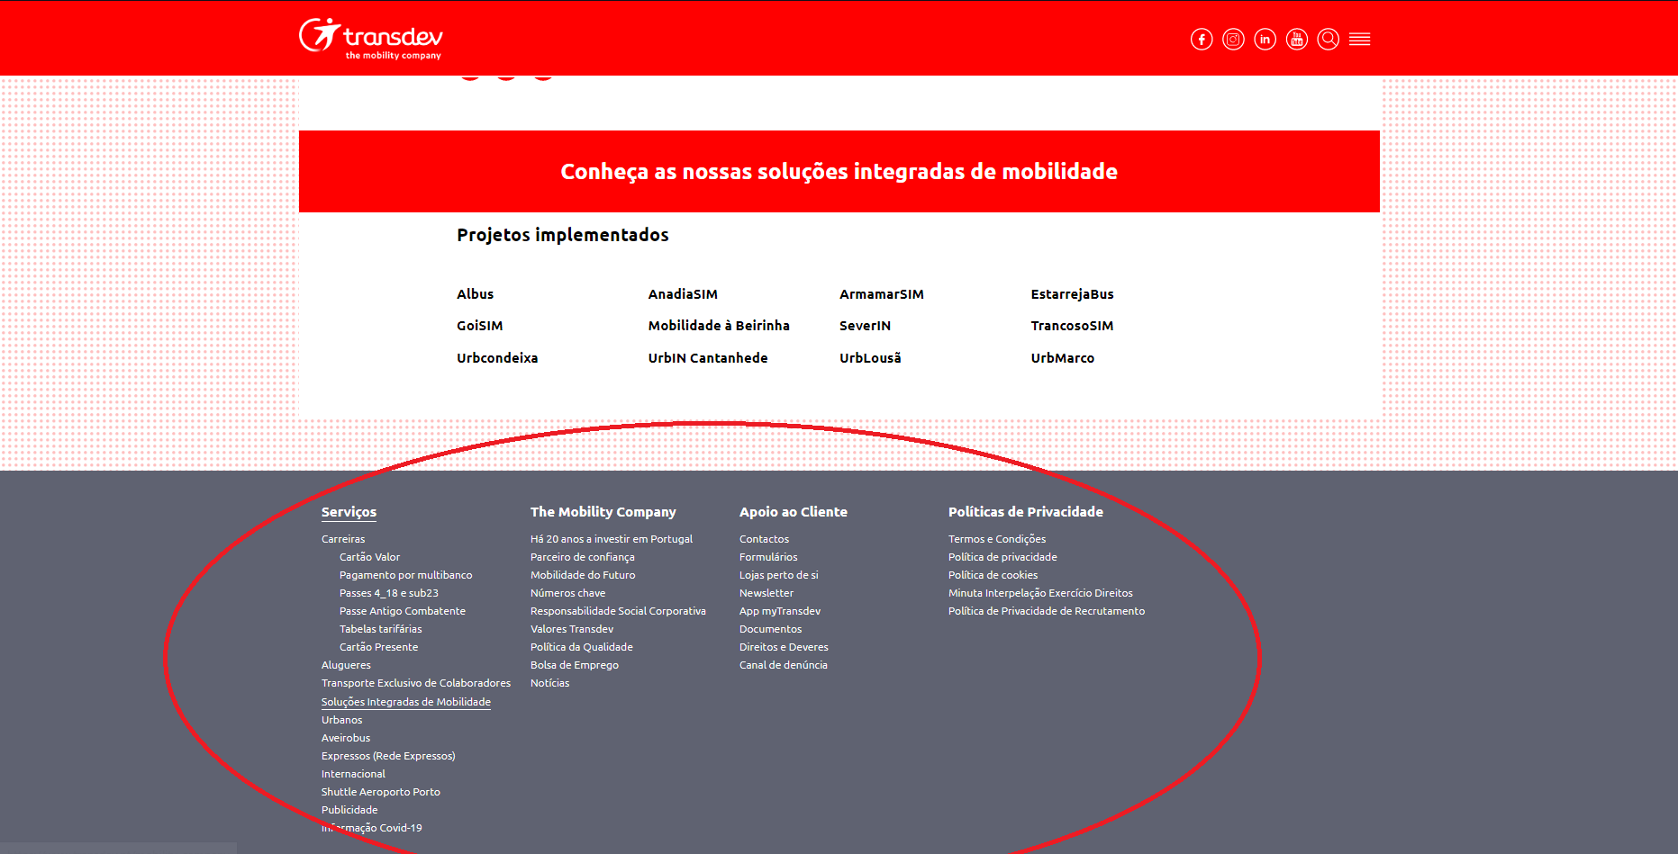
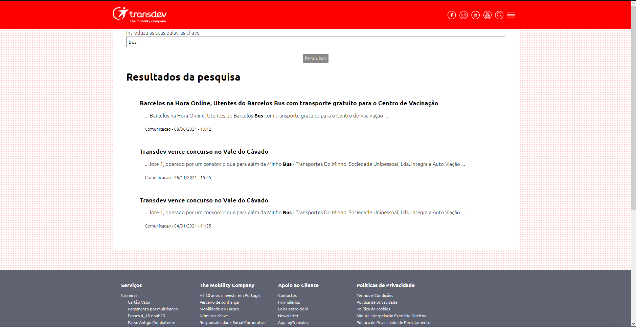
Main Issues
Video auto play
Menu
Search bar
-Issue: Most of the pages first elements are videos that auto play and are unmutable
-Heuristic: Flexibility and Efficiency of use
-Severity: 3
-Issue: Menu looks like a footer and is bad designed
-Heuristic: Asthetic and minimalistic design
-Serverity: 2
-Issue: Search bar that only search news
-Heuristic: Match between system and real world
-Severity: 2
5
5

Slide 6
Heuristic Table
 | João | José | Ricardo | Average
Travel with destination and origin in the same pin | 2 | 2 | 2 | 2
Search with transparent background | 1 | 2 | 2 | 1,67
The search is just a news search | 3 | 3 | 3 | 3
Image carousel buttons on home page too close to video | 1 | 1 | 1 | 1
6

Slide 7
Heuristic Table
 | João | José | Ricardo | Average
Videos that start automatically, covers almost the entire screen and is immutable | 3 | 3 | 3 | 3
Photos that cover a large part of the screen | 3 | 3 | 3 | 3
Main menu is the same as the footer and doesn’t have its own style | 2 | 3 | 3 | 3
7

Slide 8
Heuristic Table
 | João | José | Ricardo | Average
Form validation is not well implemented | 2 | 2 | 3 | 2,33
“Check your schedule here” can confuse the user into thinking that the text is a link to another page | 0 | 1 | 1 | 0,67
Some design mistakes | 1 | 1 | 1 | 1
8

Slide 9

Cognitive Walkthrough
What is a Cognitive Walkthrough?
A cognitive walkthrough is a technique used to evaluate the learnability of a system from the perspective of a new user. Each member of the analysis team must answer a set of questions related to the user’s perspective using the system.
Streamlined Cognitive Walkthrough
A streamlined cognitive walkthrough is a new variation of the technique that uses only two questions instead of the traditional four:
Will the user know what to do at this step?
If the user does the right thing, will they know that they did the right thing, and are making progress towards their goal?
9

Slide 10

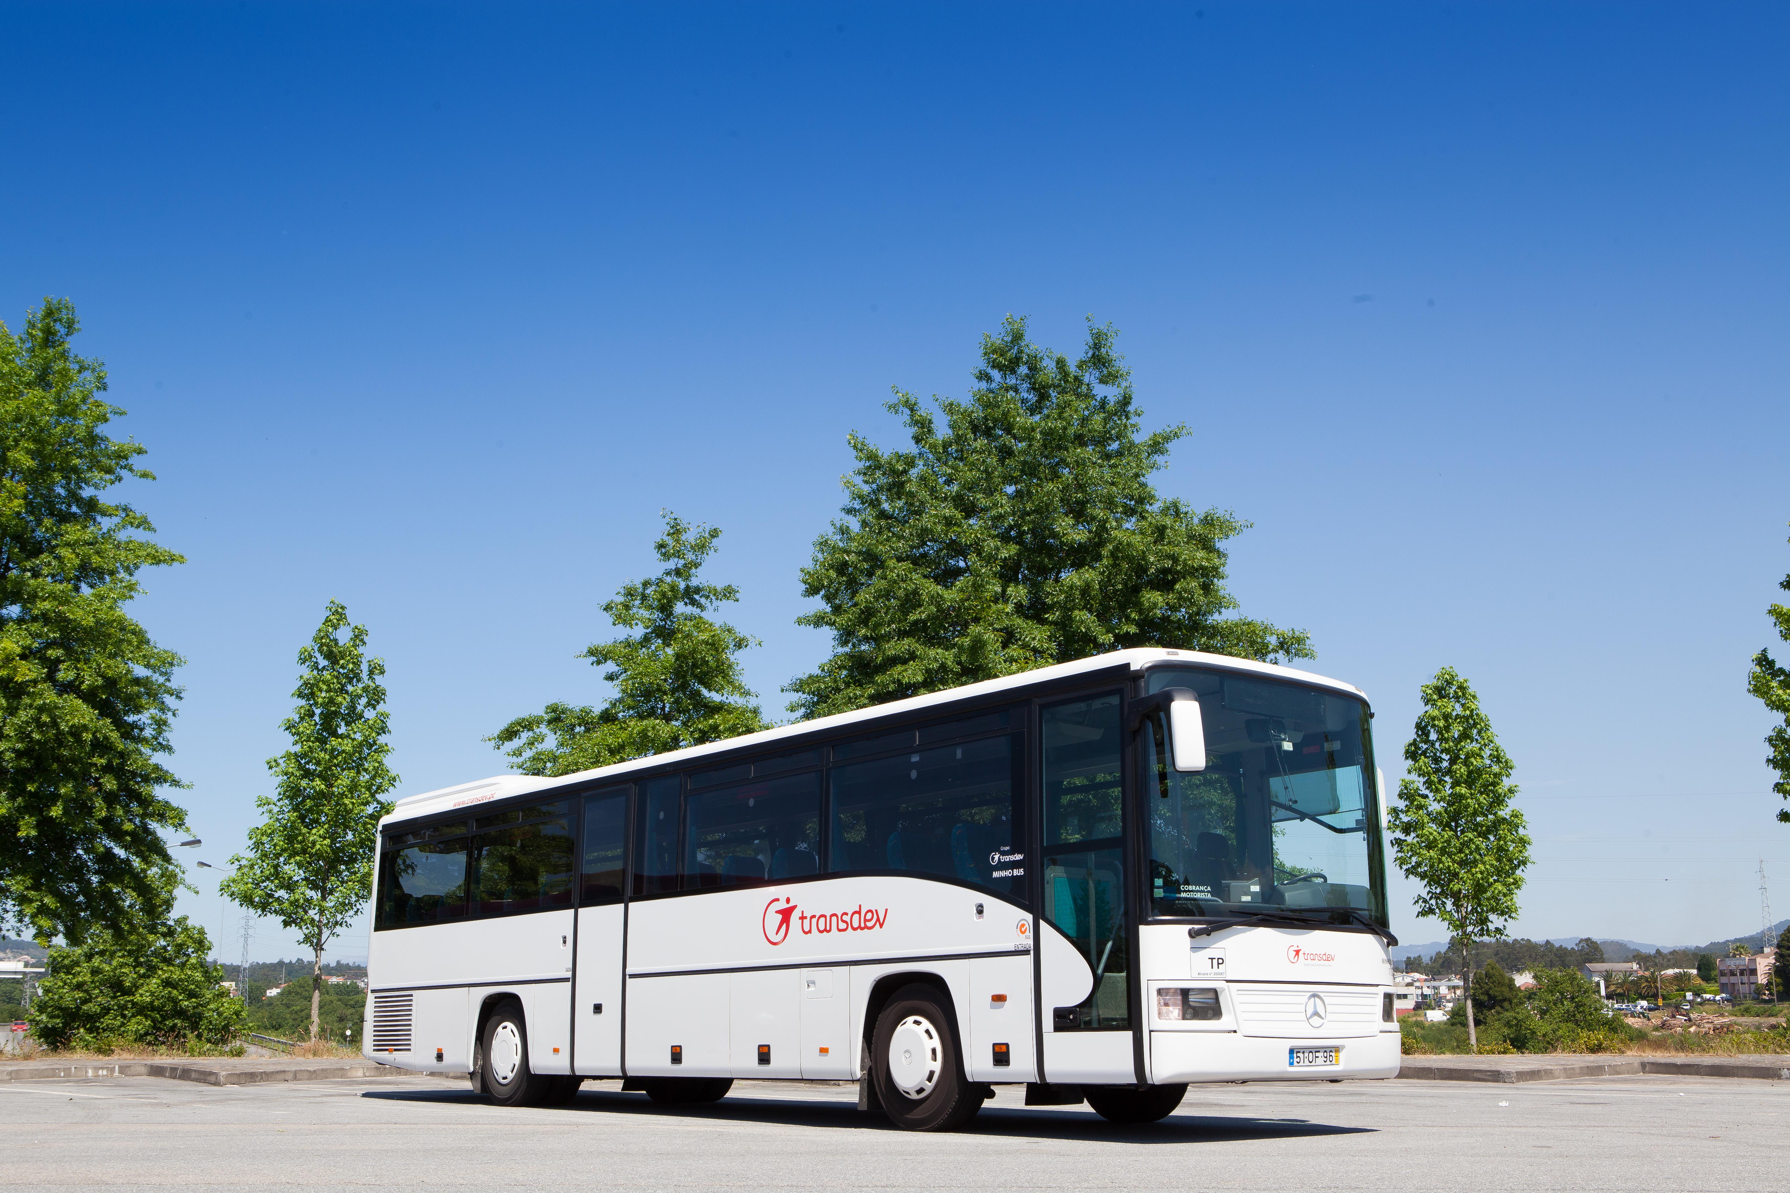
Tasks Analyzed
Search prices
Task: Check the prices of a trip from Sanfins to Albergaria-a-Nova
User: Any person above age
Actions need:
-Choose region
-Fill the form and search
-Choose the schedule
-Check the price
Rent a BUS
Task: Rent a bus to a school fieldtrip
User: Person in charge of an educational institution
Actions need:
-Select the “Alugueres" in the menu
-Select "Escolas" option
-Click “Pedir orçamento" button
-Fill the form
10

Slide 11
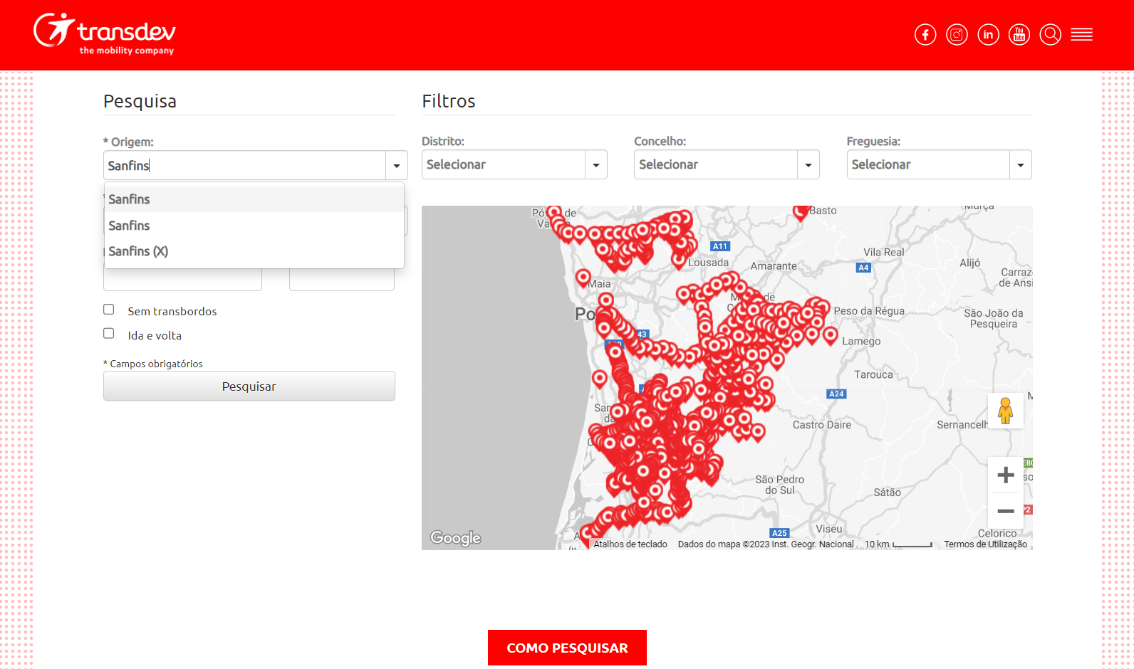
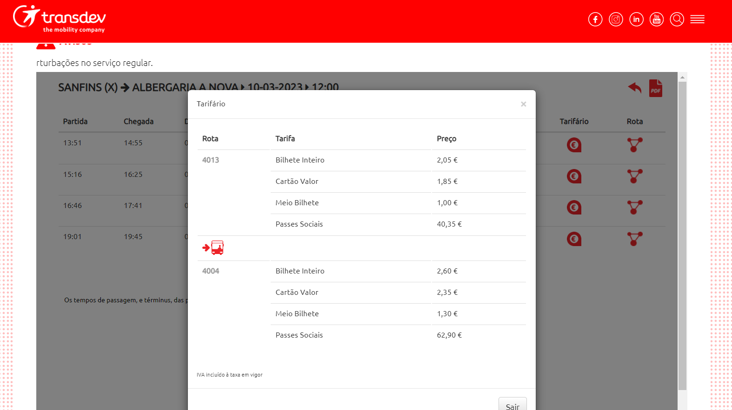
Task Search Prices - Results
Action: Fill the form and search
Q1 - Will the user know what to do at this step?
Ans: The user finds 3 equal names that indicates the same locality - Sanfins.
Q2: If the user does the right thing, will they know that they did the right thing, and are making progress towards their goal?
Ans: Yes.
Action: Check price
Q1 - Will the user know what to do at this step?
Ans: Yes, it shows the prices.
Q2 - If the user does the right thing, will they know that they did the right thing, and are making progress towards their goal?
Ans: There might be some confusion because there's different prices and no explanation why.
11

Slide 12
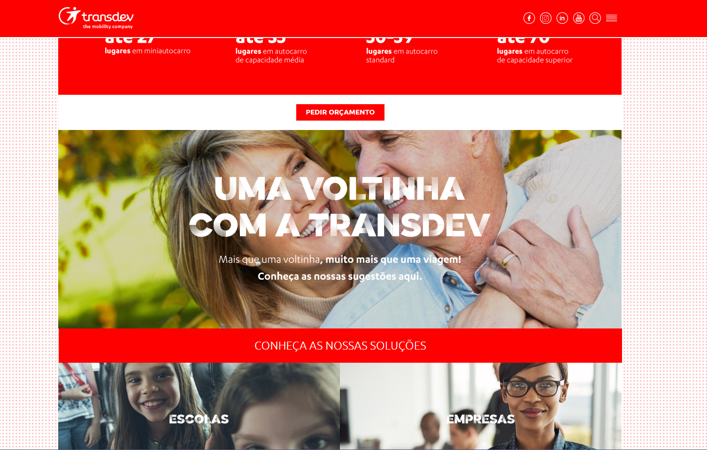
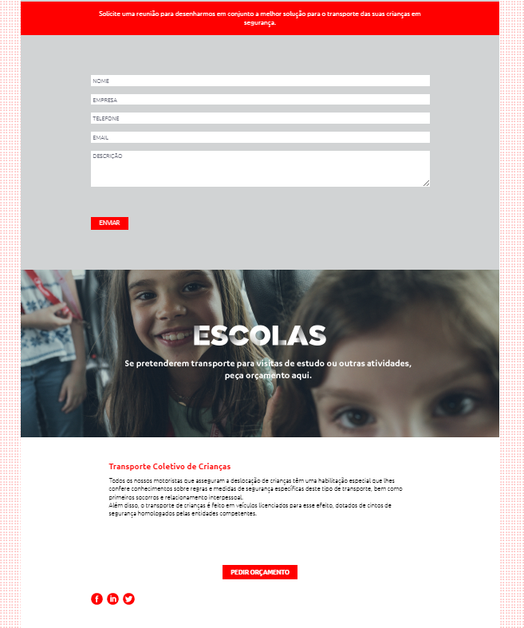

Task Rent a Bus - Results
Action: Select "Escolas"
Q1 - Will the user know what to do at this step?
Ans: Probably not, the button “Pedir orçamento" appears first in the page and its normal for the user to go for it.
Q2 - If the user does the right thing, will they know that they did the right thing, and are making progress towards their goal?
Ans: At first no, because first thing in the page is a video, after the user scrolls down, yes.
Action: Ask for budget
Q1 - Will the user know what to do at this step?
Ans: Not clearly, there are 2 forms referent to similar things that may led the user to the wrong path.
Q2 - If the user does the right thing, will they know that they did the right thing, and are making progress towards their goal?
Ans: Yes, it takes the user to the form.
12

Slide 13
Conclusions
The focus of the website should be the correct implementation of the main functionalities to ensure that they are clear and that they work.
For the average experienced web user, the product, even though it has many usability flaws, eventually provides a way to allow the user to reach its goals.
For an inexperienced user, some of the tasks that can be performed, like searching for the price of a specific trip, might not be achievable in a reasonable time.
The design is a bit out-of-date and doesn’t meet the standards of a modern website related to a bus or transportation service.
13

Slide 14
Resources
https://www.transdev.pt/
https://www.interaction-design.org/literature/topics/heuristic-evaluation
https://www.nngroup.com/articles/cognitive-walkthroughs/
14

Slide 15


Thanks!
Do you have any questions?
15

